Slide 1



OPTIMIZING BOOKING PREDICTIONS WITH AI:
A LIGHTGBM APPROACH
A machine learning model was trained to predict hotel bookings. LightGBM was chosen for its accuracy and interpretability. Key results and insights are presented.
Nivesara Tirupati

Slide 2
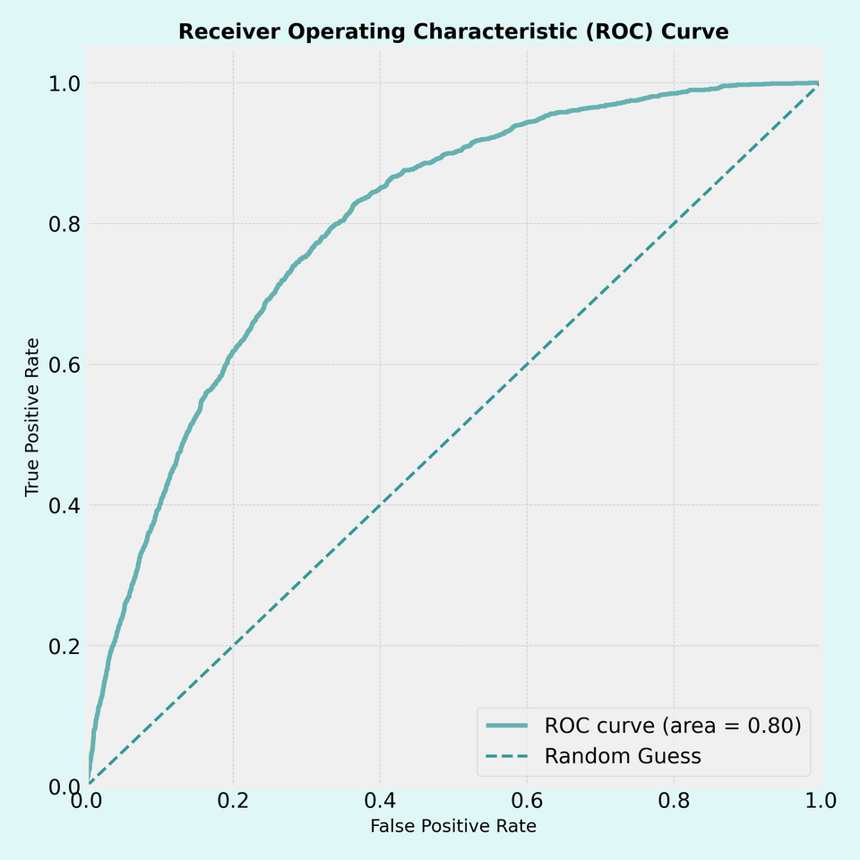
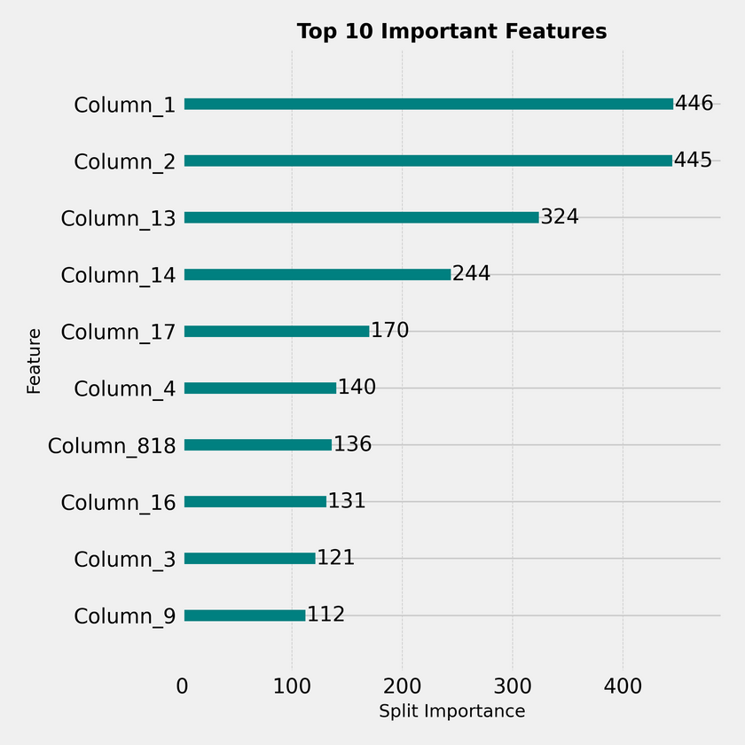
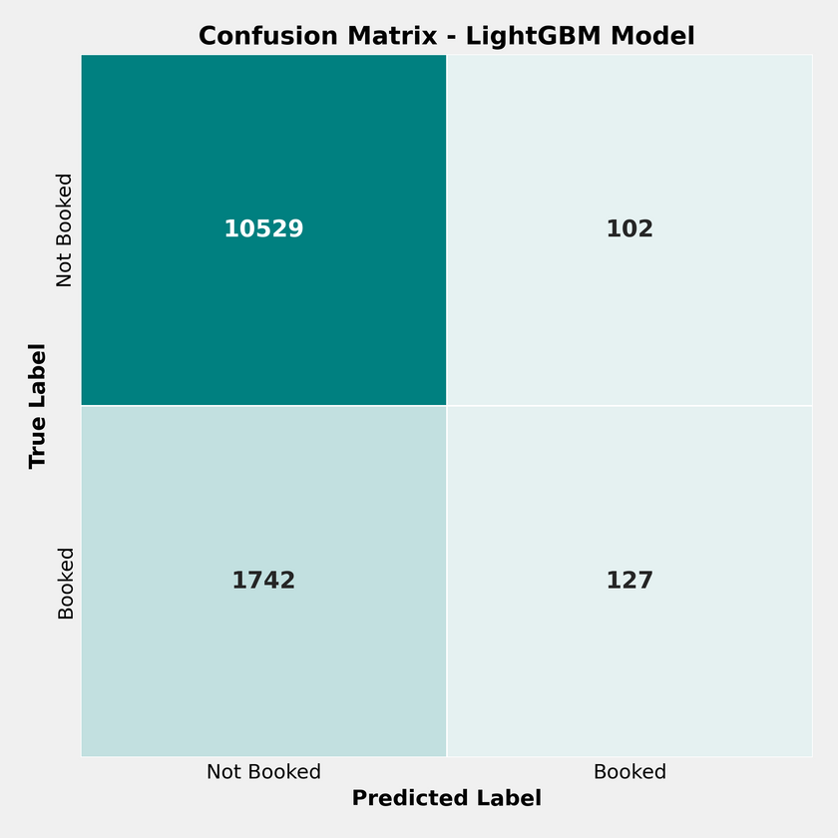
MODEL EVALUATION SUMMARY – LIGHTGBM
ACCURACY: 85.2%
ROC AUC: 0.80%
PRECISION: 53.0%
RECALL: 8.4%
F1 SCORE: 14.5%
ROC CURVE
FEATURE IMPORTANCE
CONFUSION MATRIX
Shows decent classifier performance with an AUC of 0.80—better than a random guess.
Visualizes top features influencing model output—helps with business interpretability.
Model correctly predicts most non-bookings; struggles with bookings due to class imbalance.

